Slide 1
Measuring lepton flavor violation at LHC with a long-lived slepton in the coannihilation region
Joe Sato (Saitama University )
Satoru Kaneko,Takashi Shimomura, Masato Yamanaka,Oscar Vives
Collaborators
Physical review D 78, 116013 (2008)
arXiv:1002.????

Slide 2
1, Introduction

Slide 3
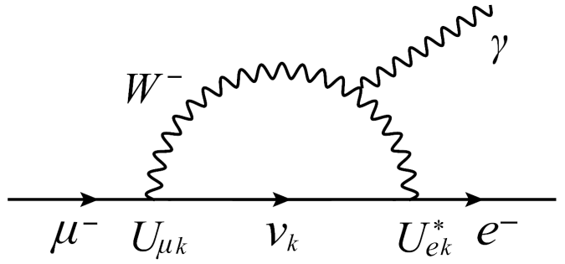
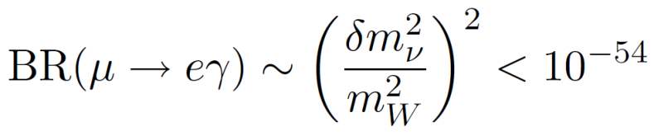
1, Introduction
In Standard Model (SM)
Lepton Flavour Violation (LFV) through the neutrino oscillation
But …
Forever invisible
Detection of the LFV signal
One of the evidence for beyond the SM

Slide 4
1, Introduction
One of the candidates for beyond the SM
Supersymmetric (SUSY) model
Supersymmetry
Symmetry between boson and fermion
Lepton Slepton
Gauge boson Gaugino
Why SUSY models ??
Stability of Higgs mass, dark matter, gauge coupling unification, hierarchy problem, and so on

Slide 5
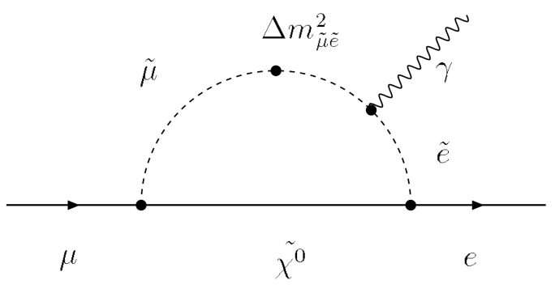
1, Introduction
In Supersymmetric (SUSY) models
Enhancement of LFV through the slepton mixing
Detectable at future experiments
Understanding the structure of slepton mixing
Observational results of LFV search experiments
Possible to confirm the SUSY model !

Slide 6
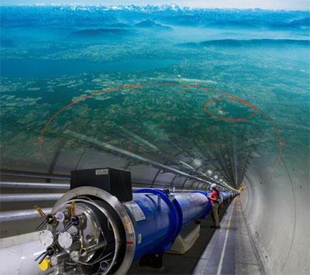
1, Introduction
Purpose in this work
Understanding the structure of slepton mixing
What is the key ingredient ?
Long-lived stau
Where is the stage ?
Large Hadron Collider (LHC) experiment

Slide 7
2, Long-lived stau

Slide 8


Setup in the work
Framework
Minimal Supersymmetric Standard Model (MSSM)
Lightest supersymmetric particle (LSP)
Lightest neutralino
Dark matter
∴
R-parity
Next Lightest Supersymmetric Particle (NLSP)
Lighter stau

Slide 9
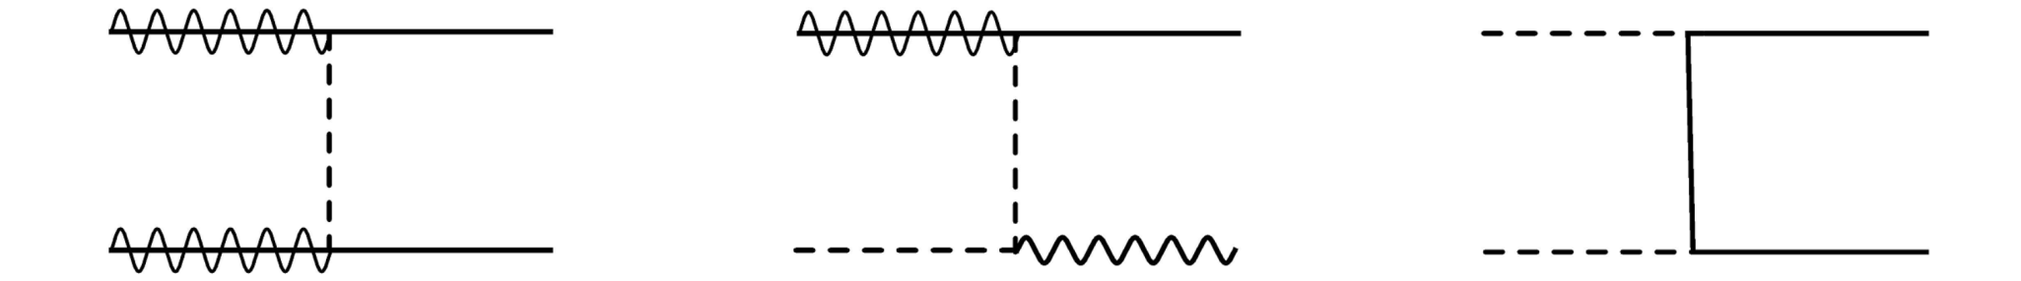



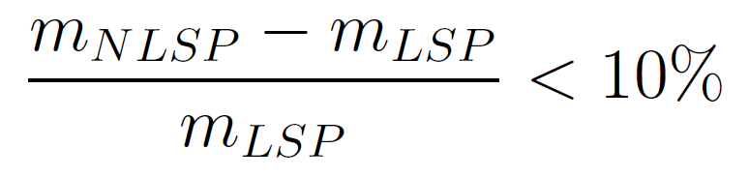
Coannihilation scenario
[ K. Griest and D. Seckel PRD 43 (1991) ]
At around the same time
LSP DM and NLSP stau decouple from thermal bath
Enough to reduce DM density
Providing DM abundance consistent with WMAP
Requirement for
coannihilation scenario

Slide 10
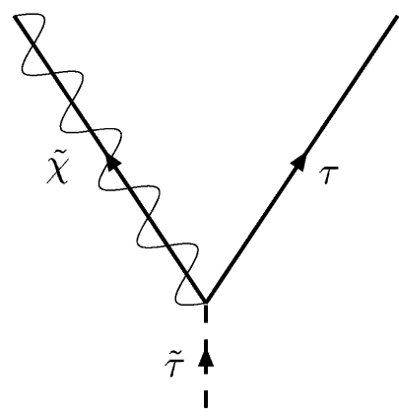
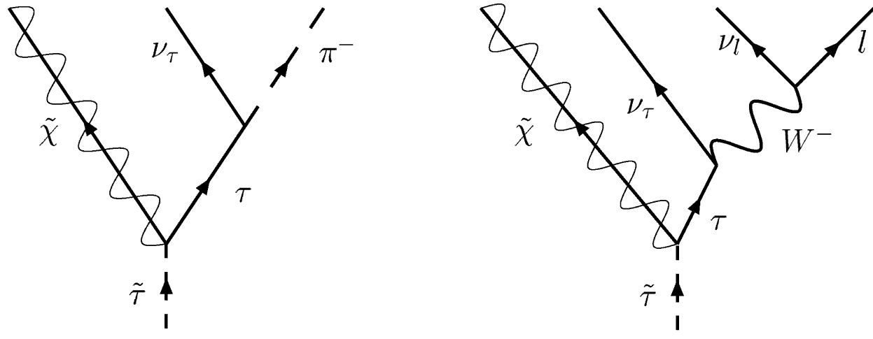
Long-lived stau in the coannihilation scenario
Attractive parameter region in coannihilation scenario
δm ≡ NLSP mass － LSP mass < tau mass
(1.77GeV)
Can not decay into two body
Phase space suppression
Long lifetime

Slide 11
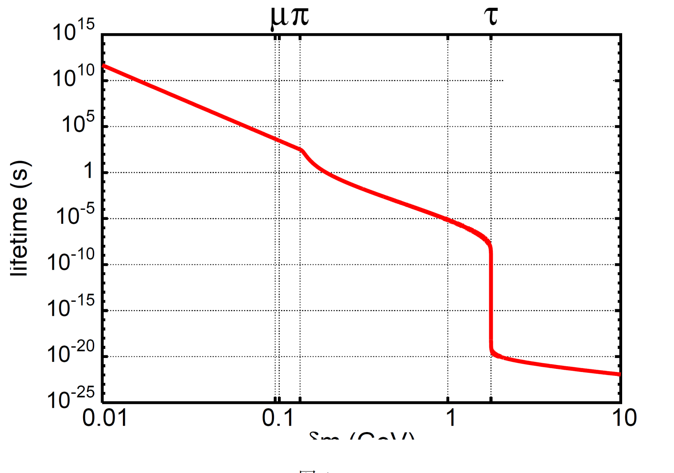




Long-lived stau
Phys. Rev. D73:055009-1-8, 2006
Stau lifetime (s)
Without slepton mixing
At the LHC, the long-lived stau would be produced
Available for investigating the slepton mixing

Slide 12
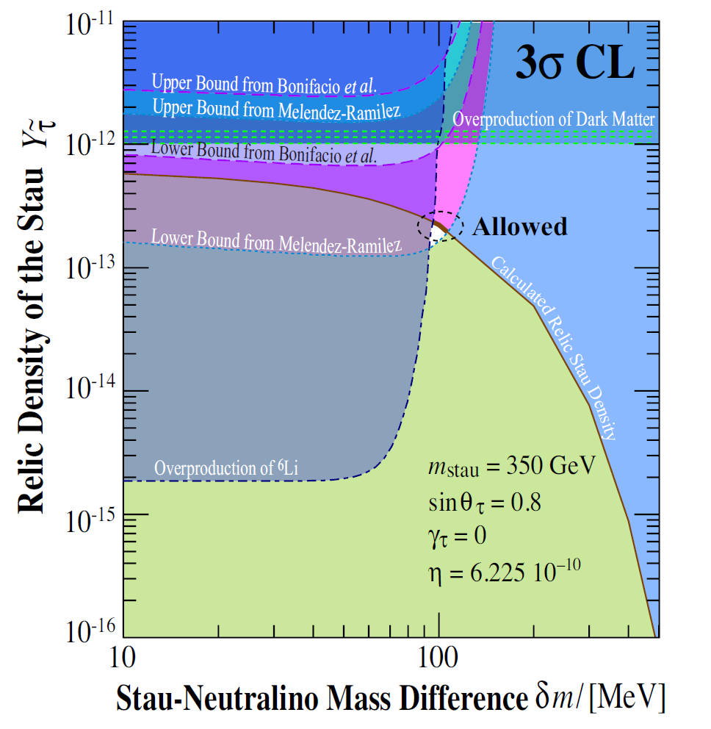
Furthermore it can offer a solution to Lithium
Problem in Standard Big-Bang Nucleosynthesis
Phys.Rev.D76:125023,2007Phys.Rev.D78:055007,2008arXiv:1001.1217

Slide 13
3, Slepton mixing as a source of LFV

Slide 14

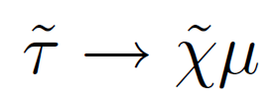
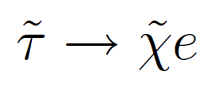
With or without slepton mixing
Without slepton mixing
Impossible to decay into two body
Long-lived and would escape from detector
With slepton mixing
Decay into two body opens !
~
2
Decay rate of stau ( Slepton mixing )
Measurements of the stau lifetime
Strong sensitibity to slepton mixing parameter

Slide 15
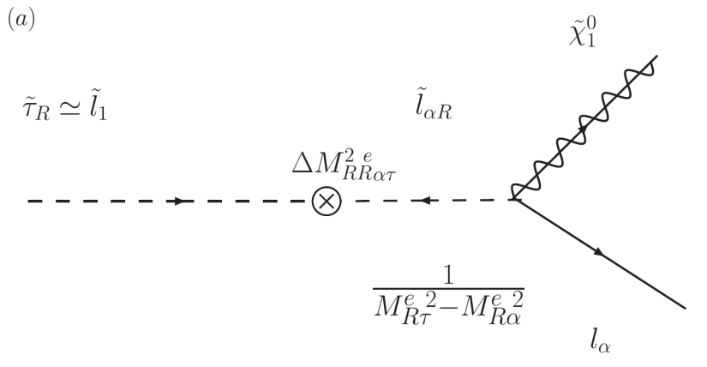





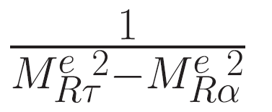


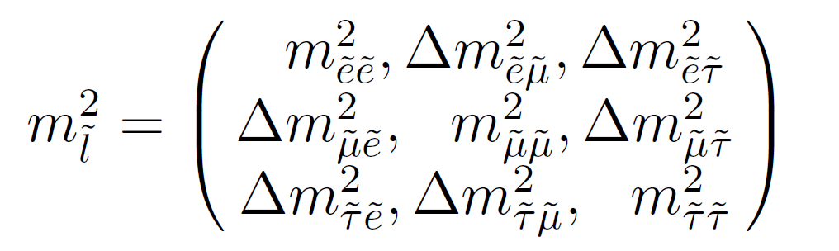
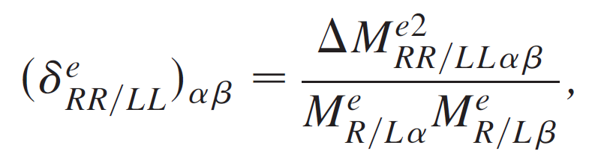
Decay with slepton mixing
Decay process with LFV
Slepton mass matrix
Slepton mixing parameter

Slide 16
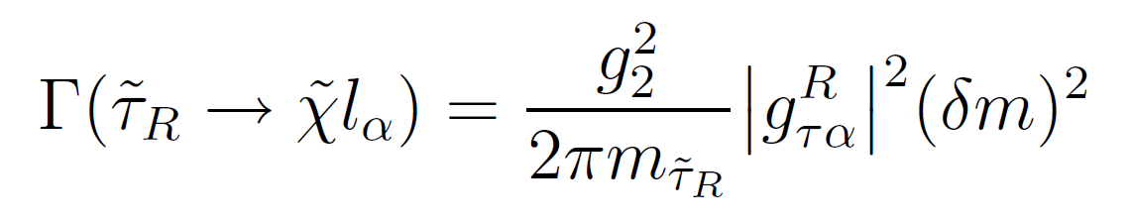
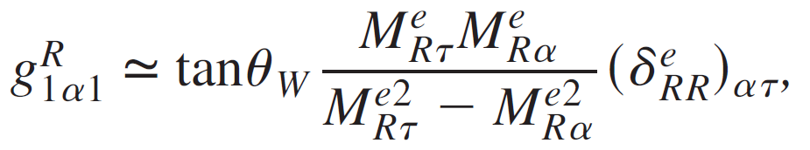
Decay with slepton mixing
Decay process with LFV
Decay rate
Effective coupling
Slepton mixing parameter

Slide 17
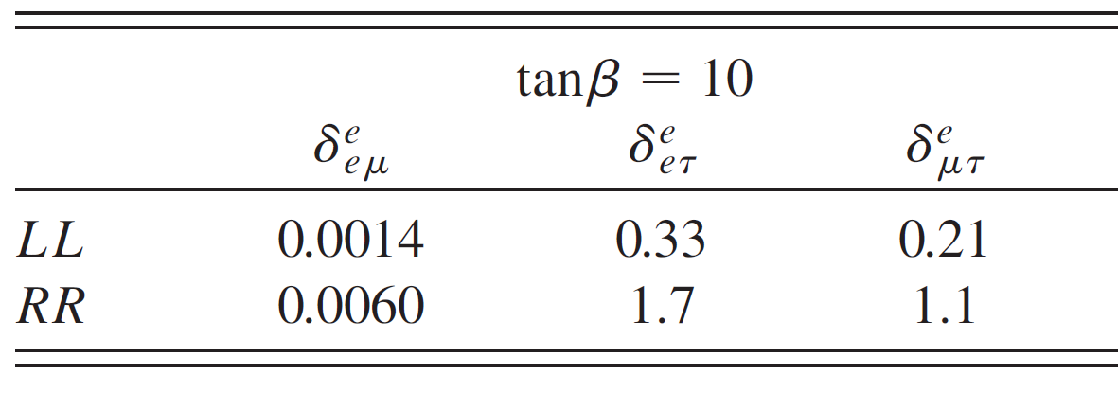
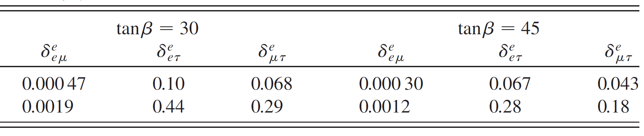
Bounds on slepton mixing parameter
Slepton mixing parameter
Bounds on slepton mixing parameter
⋍
For stau mass 300GeV
L. Calibbi, J. Jones-Perez, and O. Vives, Phys. Rev. D 78,075007 (2008).
More strict constraint on mixing parameter !

Slide 18
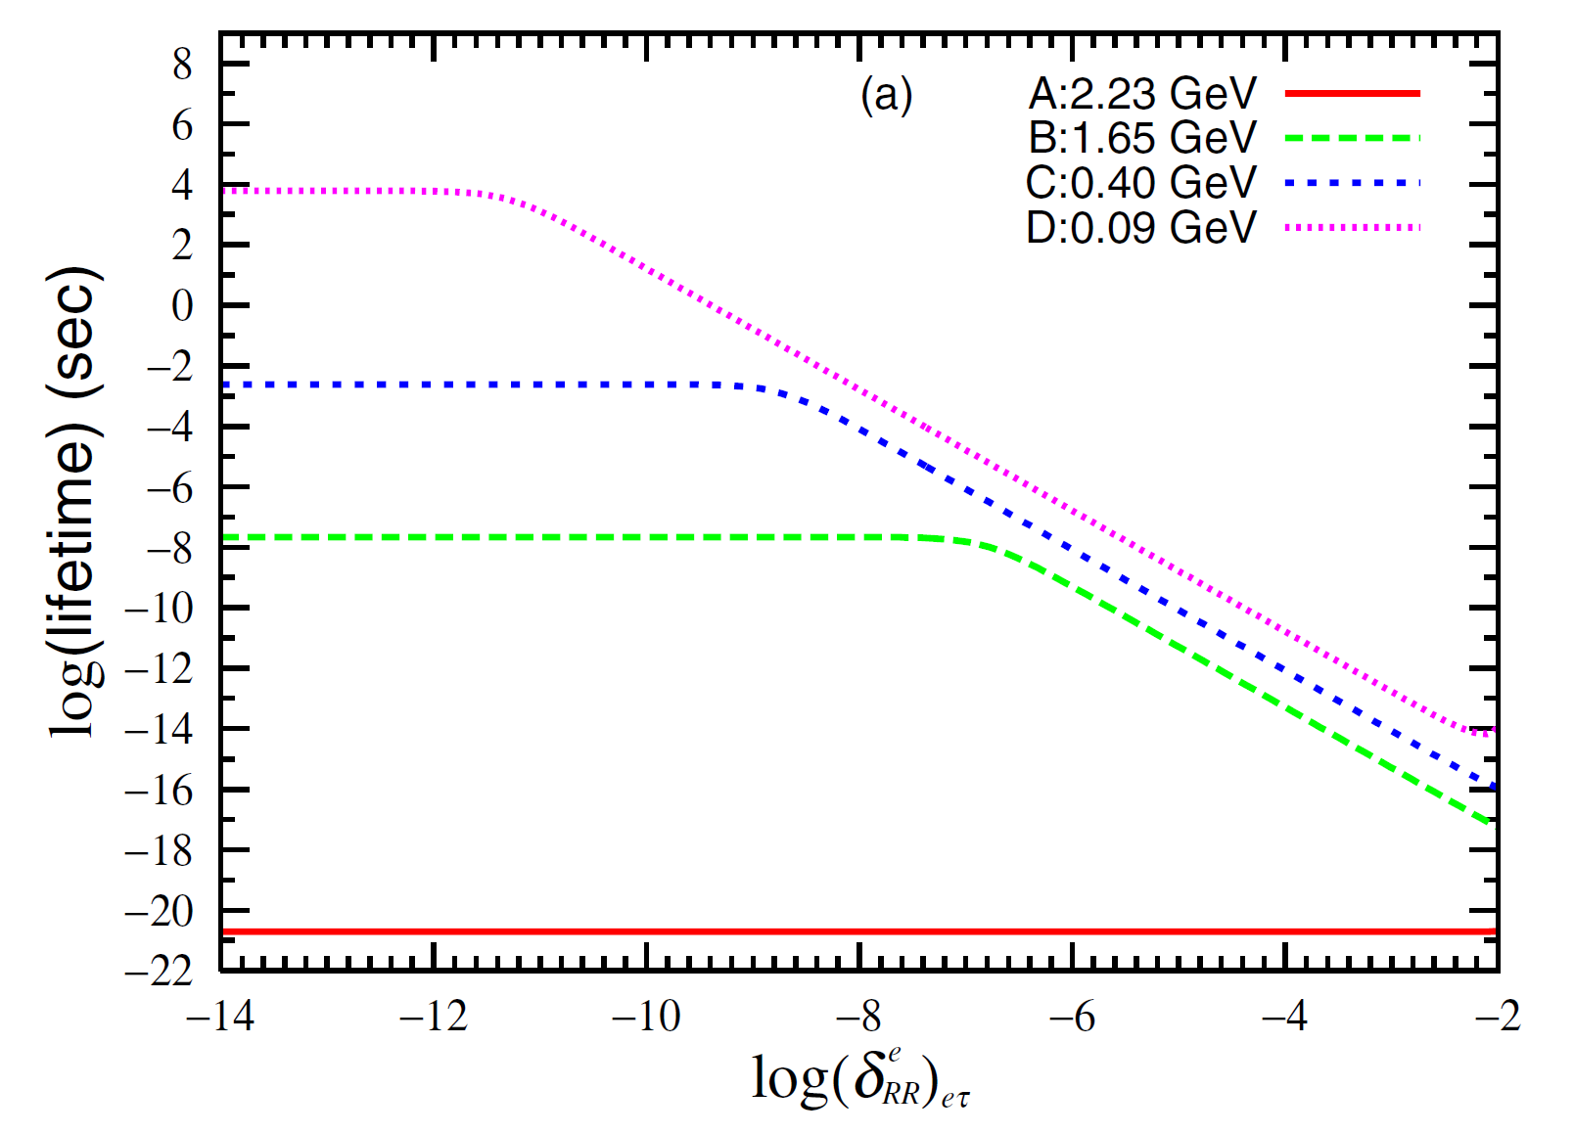






Stau lifetime with LFV
Stau lifetime (s)
With slepton mixing

Slide 19
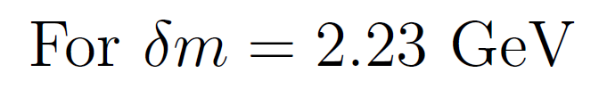
Stau lifetime with LFV
Stau lifetime (s)
With slepton mixing
Stau decay into tau and neutralino
Insensitive to slepton mixing parameter

Slide 20
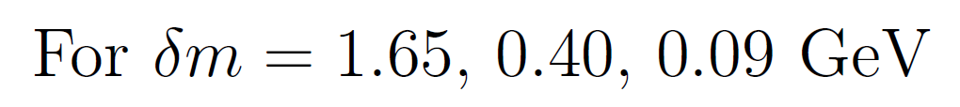
Stau lifetime with LFV
Stau lifetime (s)
With slepton mixing
Competition between LFV decay and 3(4) body decay
Very good sensitivity to small slepton mixing parameter

Slide 21
4, LHC phenomenology

Slide 22
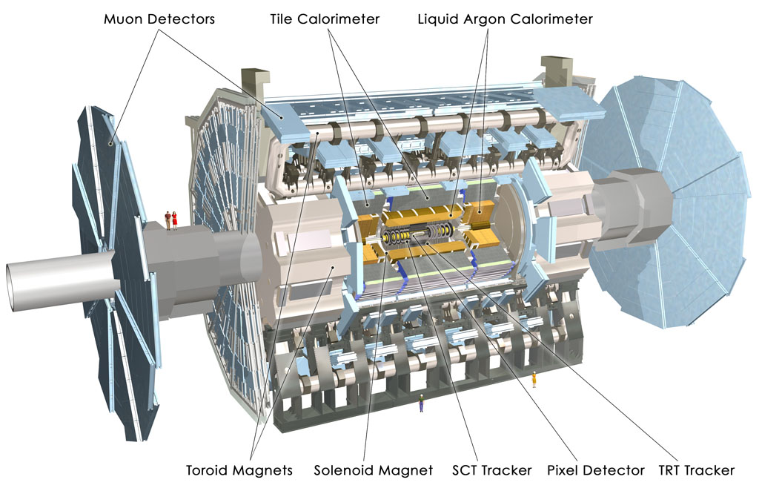




Looking for stau and that decay at the ATLAS
One of the LHC detector
ATLAS
Production rate of SUSY particles
⋍
For stau mass 300GeV
[ P.Z. Skands, Eur. Phys. J. C 23, 173 (2002) ]
Produced number of stau

Slide 23
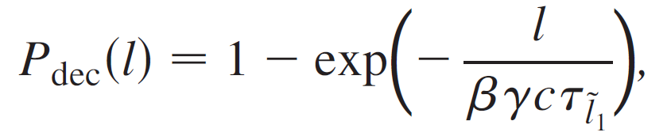
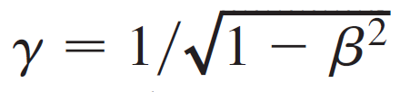

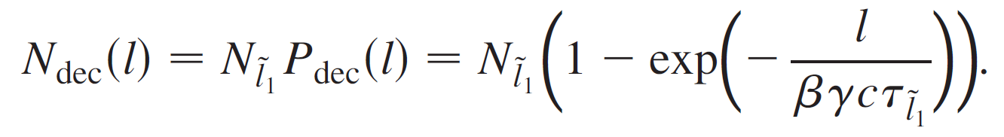

Expected number of stau decay at the ATLAS
Decay probability
Lorentz factor
Expected number of decay
In the following discussion

Slide 24
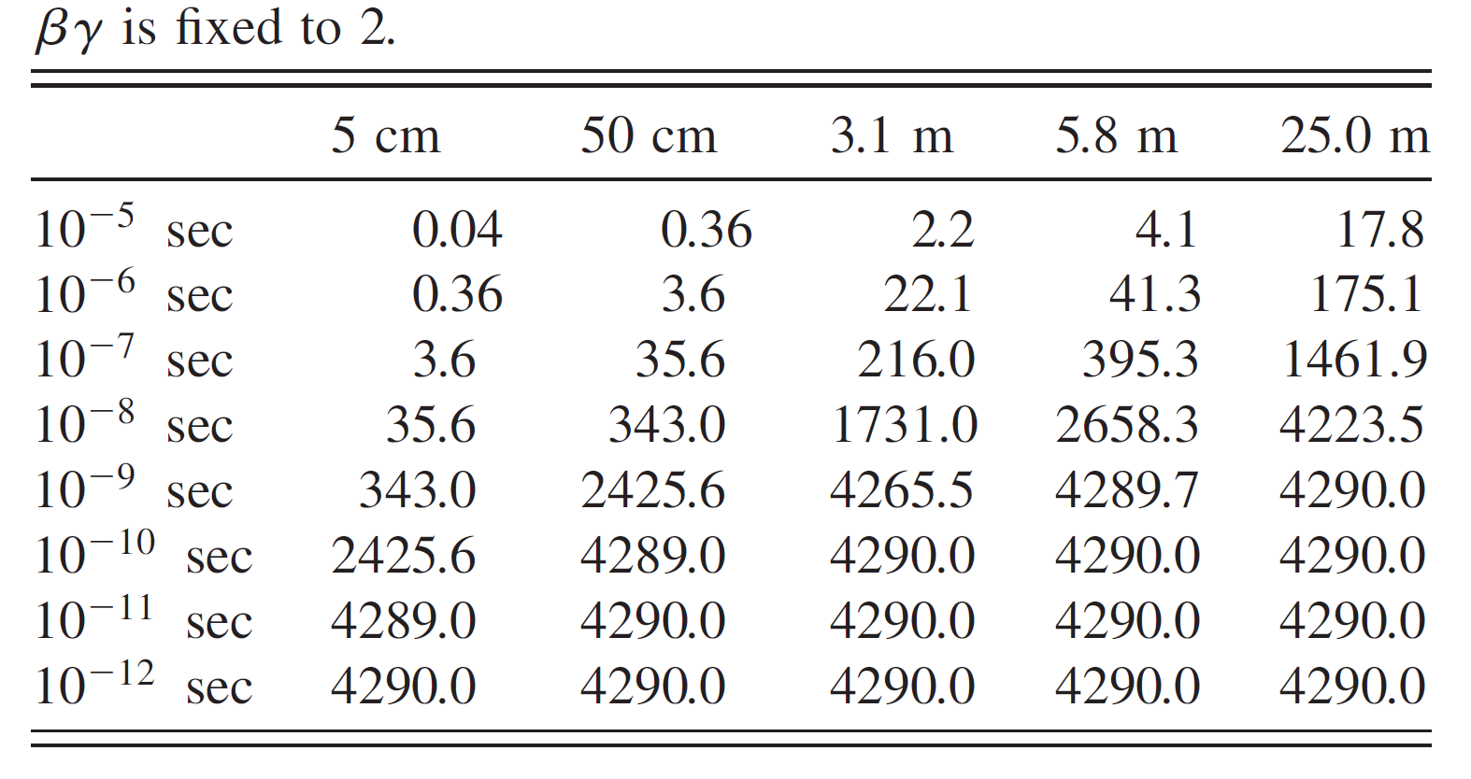

Constraint on slepton mixing parameter at ATLAS
Expected number of LFV stau decay
All of the staus decay before they reach detectors
No signals of heavy charged particle

Slide 25

Constraint on slepton mixing parameter at ATLAS
Expected number of LFV stau decay
Stau lifetime (s)
All of the staus decay before they reach detectors
No signals of heavy charged particle
Lower bound on slepton mixing parameters

Slide 26
Constraint on slepton mixing parameter at ATLAS
Expected number of LFV stau decay
Staus decay inside detectors

Slide 27
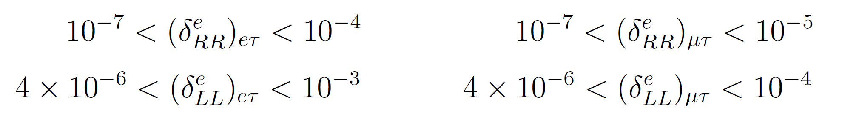
Constraint on slepton mixing parameter at ATLAS
Expected number of LFV stau decay
Stau lifetime (s)
Staus decay inside detectors
Slepton mixing parameters are strictly constrained

Slide 28
Constraint on slepton mixing parameter at ATLAS
Expected number of LFV stau decay
All of staus leave detectors
Lower bound on stau lifetime

Slide 29
Constraint on slepton mixing parameter at ATLAS
Expected number of LFV stau decay
Stau lifetime (s)
All of staus leave detectors
Stringent upper bounds on slepton mixing parameters
For further study on LFV
Let’s construct bigger detector !!

Slide 30
5, Summary and discussion

Slide 31
Summary
Slepton mass matrix includes off-diagonal elements, and it leads to Lepton Flavour Violation (LFV)
Important to understand slepton mixing structure for study LFV
In the MSSM coannihilation scenario, NLSP stau can be long-lived
Stau lifetime is sensitive to the slepton mixing
Stau lifetime > 10 (s)
-12
Strict lower bound on slepton mixing parameter
10 (s) < lifetime < 10 (s)
-10
-8
Stau lifetime > 10 (s)
-5
Strict upper bound on slepton mixing parameter
LHC provides a very good opportunity to study LFV !!

Slide 32


Discussion
What is the source of slepton mixing ??
SUSY seesaw models with right-handed neutrinos
Energy scale
LFV source in the neutrino Yukawa matrix
Renormalization Group Evolution (RGE)
Energy scale
Slepton mixing in slepton mass matrix
Slepton mixing parameter

Slide 33



Discussion
What is the source of slepton mixing ??
SUSY seesaw models with right-handed neutrinos
Energy scale
LFV source in the neutrino Yukawa matrix
Renormalization Group Evolution (RGE)
Energy scale
Slepton mixing in slepton mass matrix
For large mixing (MNS-like)
An element of MNS matrix

Slide 34


Discussion
What is the source of slepton mixing ??
SUSY seesaw models with right-handed neutrinos
Energy scale
LFV source in the neutrino Yukawa matrix
Renormalization Group Evolution (RGE)
Energy scale
Slepton mixing in slepton mass matrix
For small mixing (CKM-like)

Slide 35
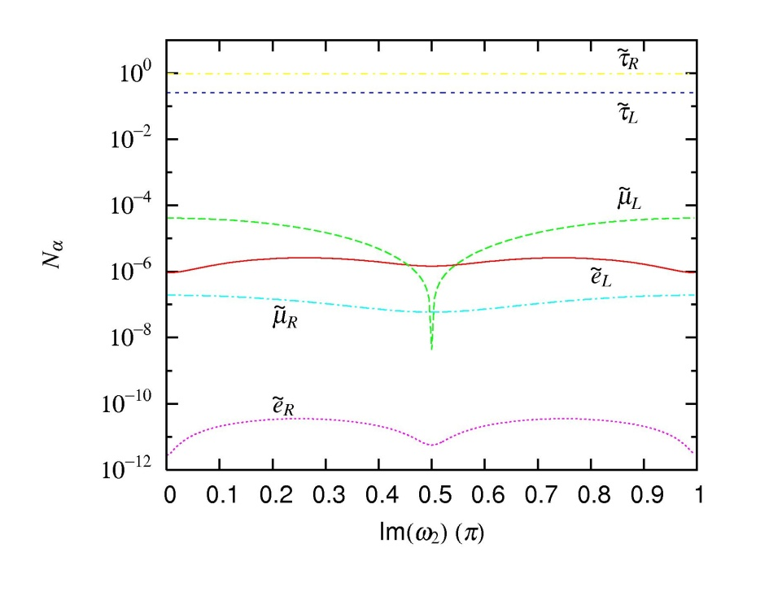
Example in MSSM with RH neutrino

Slide 36
Appendix

Slide 37

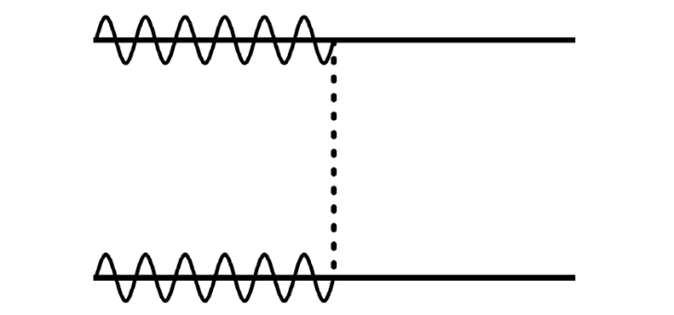

Original thermal relic scenario
On the stage of DM freeze-out
Decouple species : DM only
Pair annihilation rate of DM decides DM relic abundance
Too week to reduce DM density sufficiently
DM over abundance !!

Slide 38
Coannihilation scenario
[ K. Griest and D. Seckel PRD 43 (1991) ]
On the stage of DM freeze-out
Decouple species : DM and NLSP
Annihilation rates of DM and NLSP decide DM relic abundance
Enough to reduce DM density
Providing DM abundance consistent with WMAP

Slide 39
Requirement for coannihilation
For the coannihilation process
Two species decoupling at around the same time
Ingredient of the decoupling point
mass of decoupling particle
Requirement for coannihilation mechanism

Slide 40
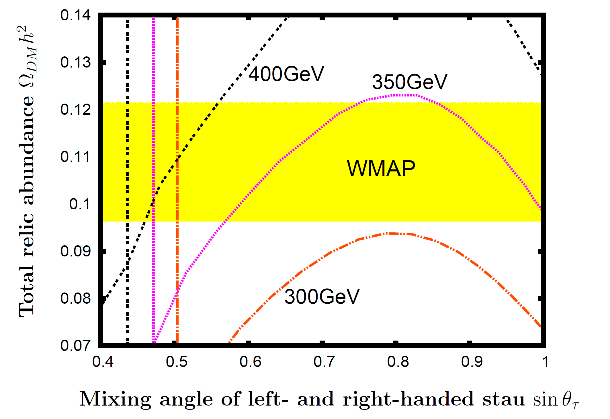
Total abundance of stau and neutralino

